Slide 1
Real Estate analysis
George Drakulic
gdrakulic@gmail.com
https://www.linkedin.com/in/drakulic
https://github.com/drakulic/Capstone
San Francisco
2013 November 12 – 2016 November 08
Districts 7, 8, and 10

Slide 2

Districts 7, 8, and 10 4339 data points, 35 features
Bedroom
Bath
Parking
Sqft
home_own_ass
day_on_market
single_f_h
Condo
dist_no
sold_year
sold_month
Bayview Heights
Bayview
Candlestick Point
Cow Hollow
Crocker Amazon
Downtown
Excelsior
Financial District
Hunters Point
Little Hollywood
Marina
Mission Terrace
Nob Hill
North Beach
North Waterfront
Outer Mission
Pacific Heights
Portola
Presidio Heights
Russian Hill
Silver Terrace
Telegraph Hill
Van Ness/Civic Cente
Visitacion Valley

Slide 3
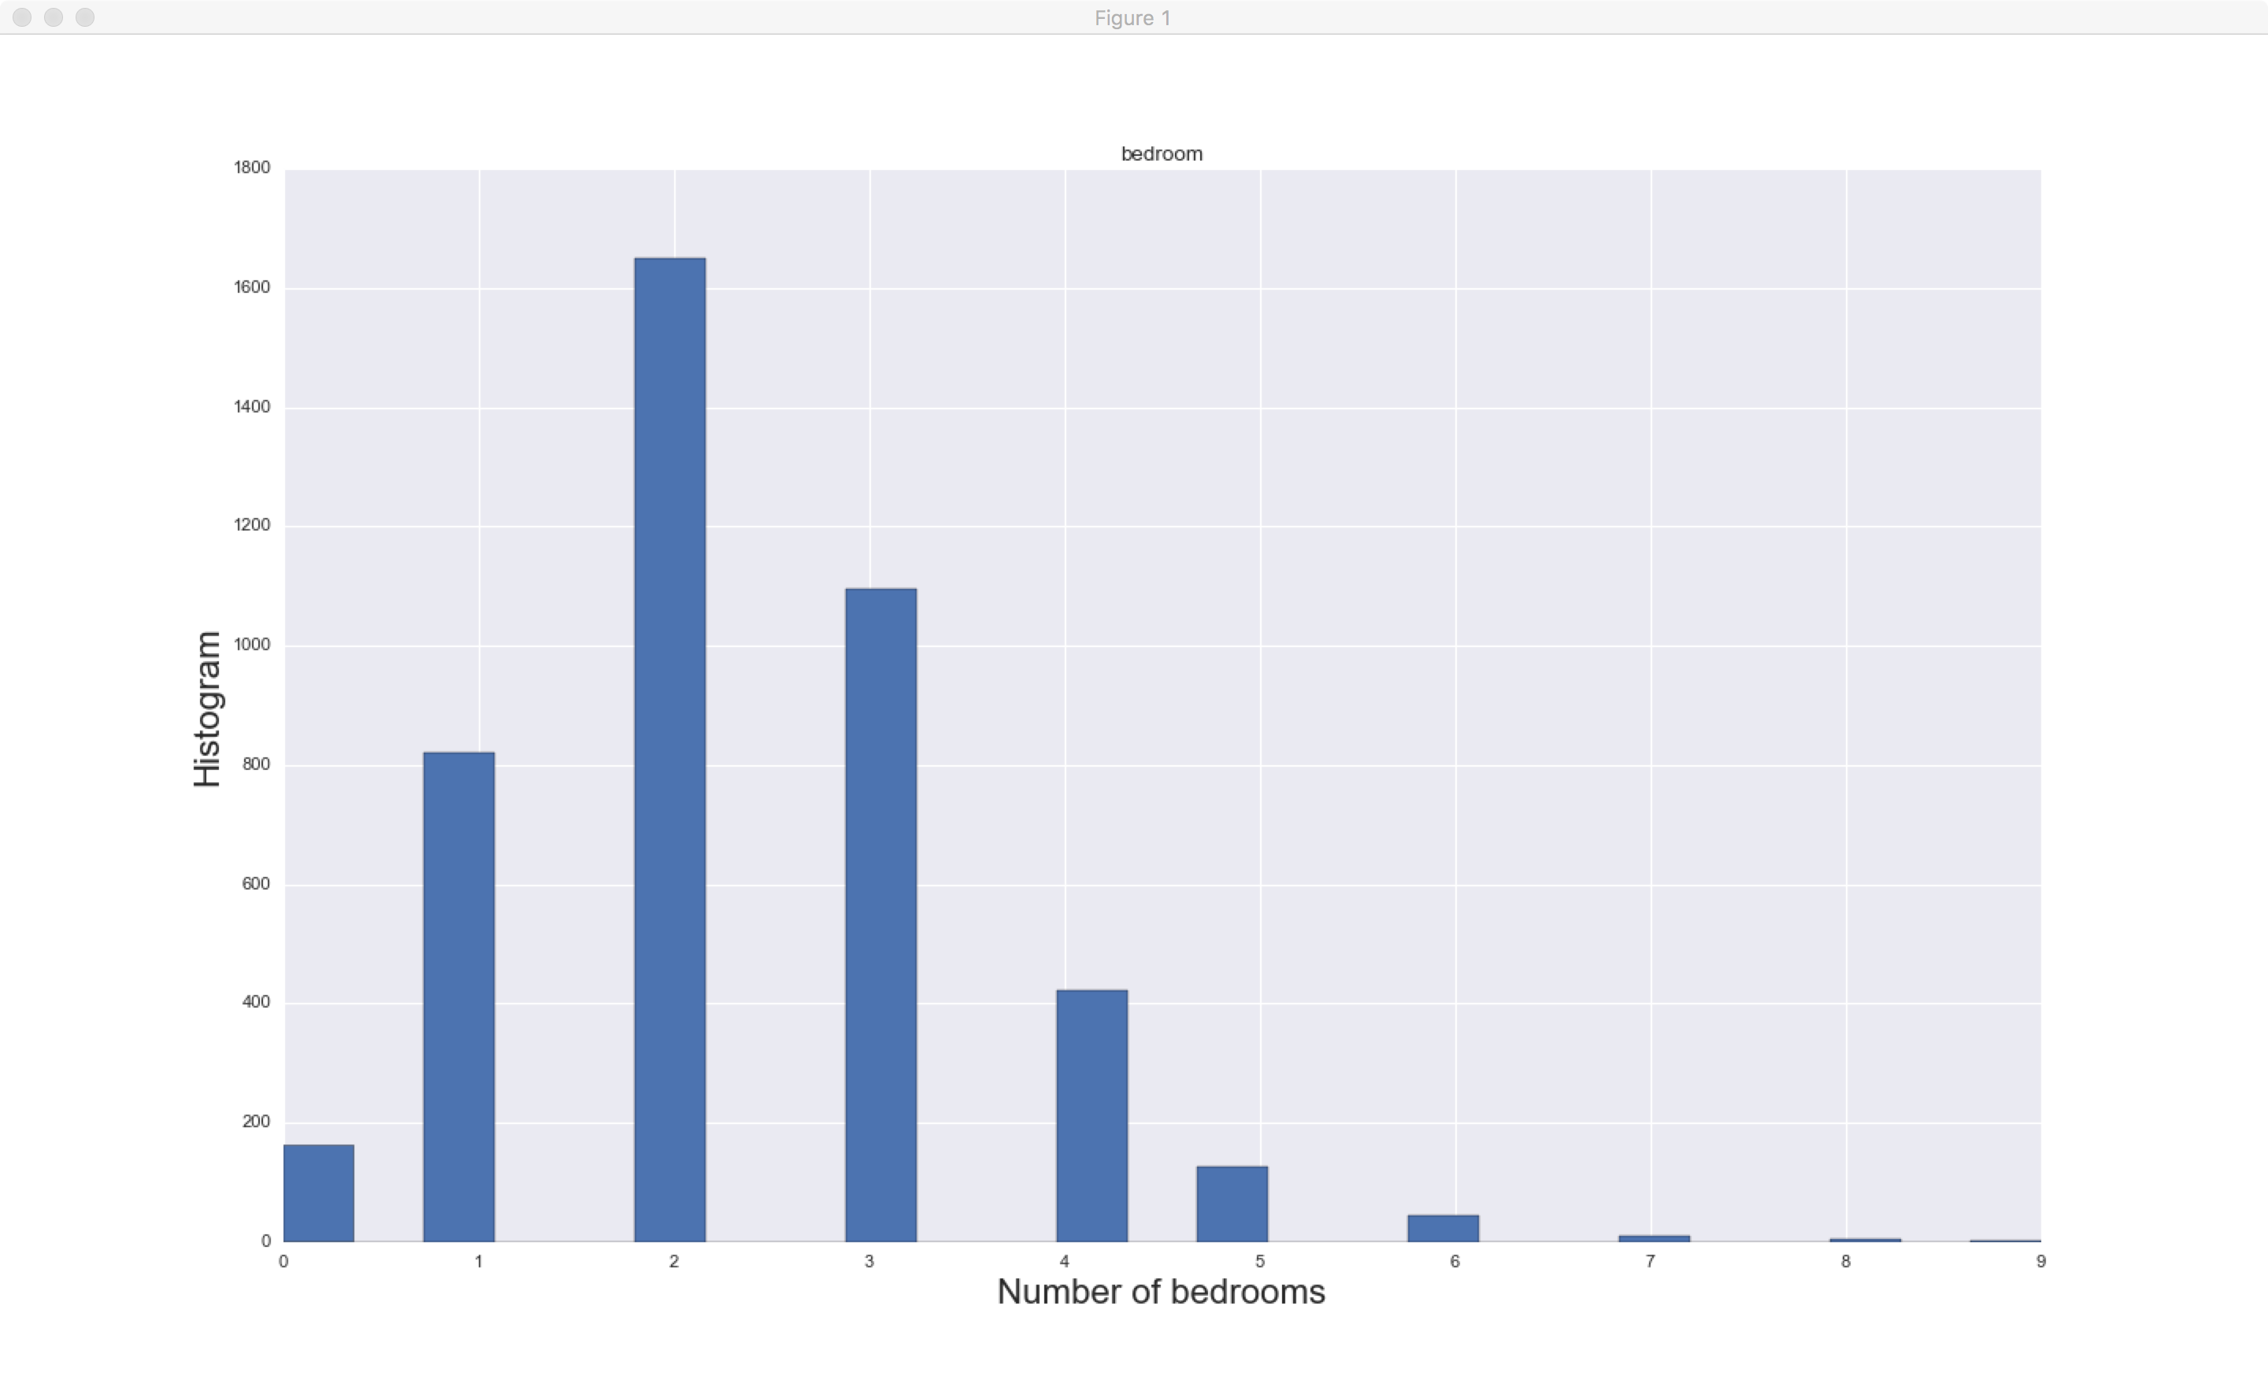
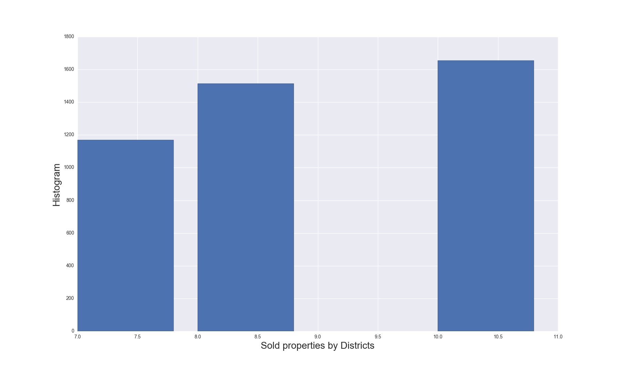
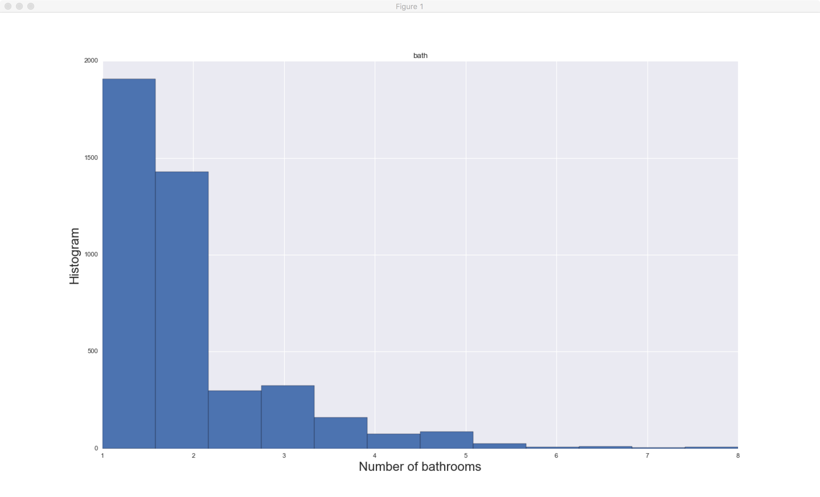
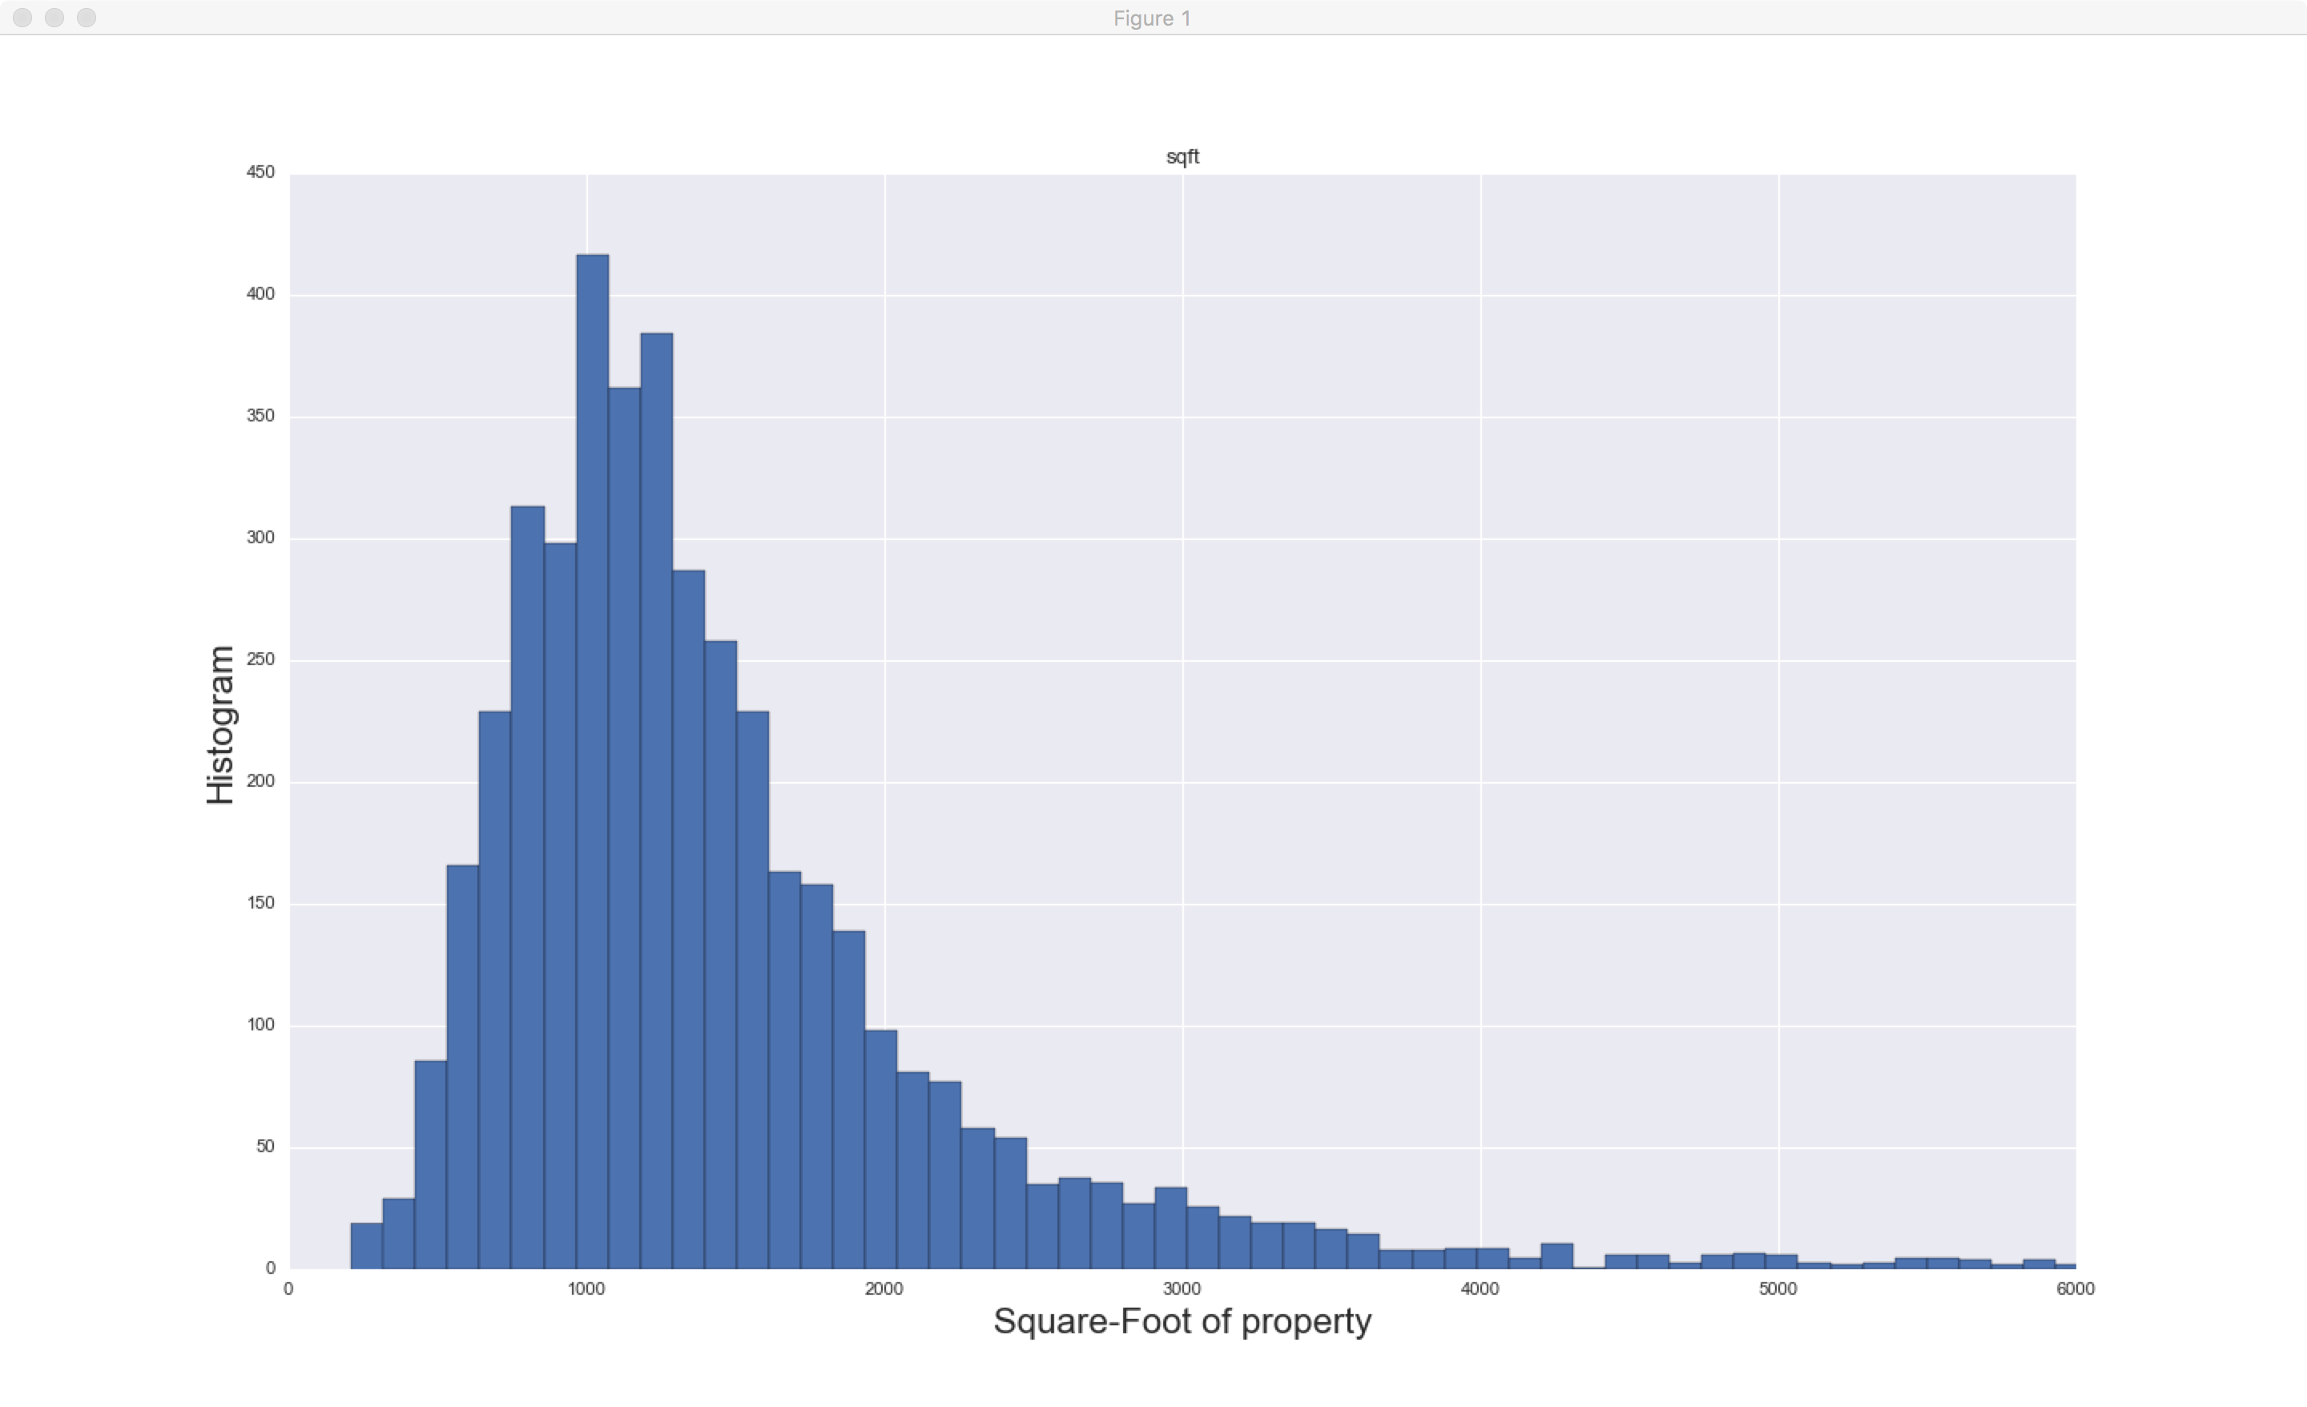
Exploratory data analysis

Slide 4
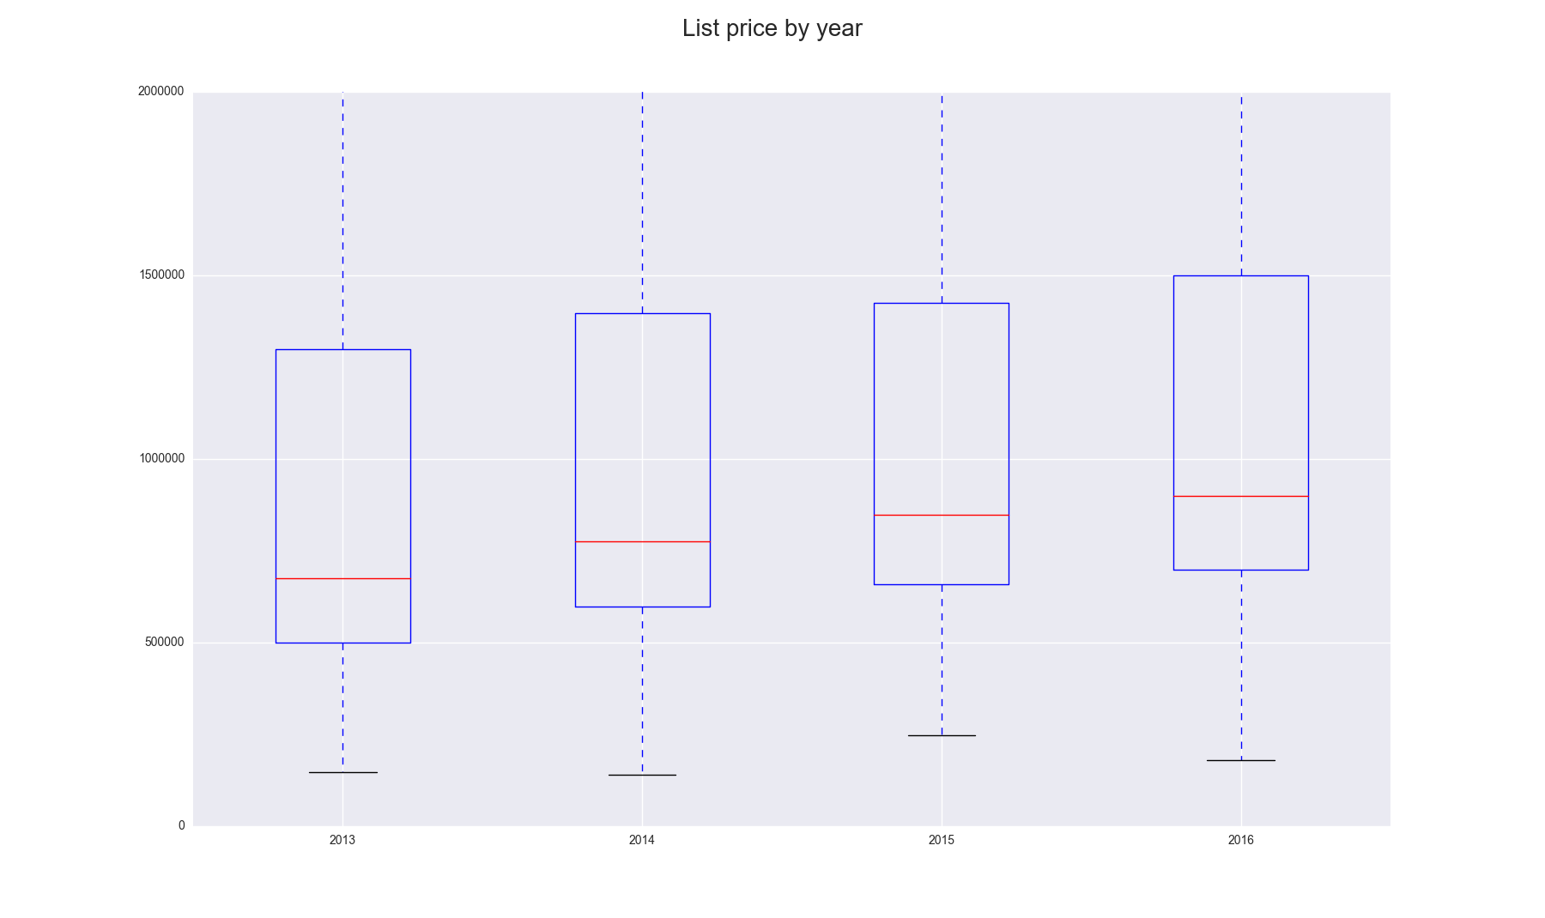
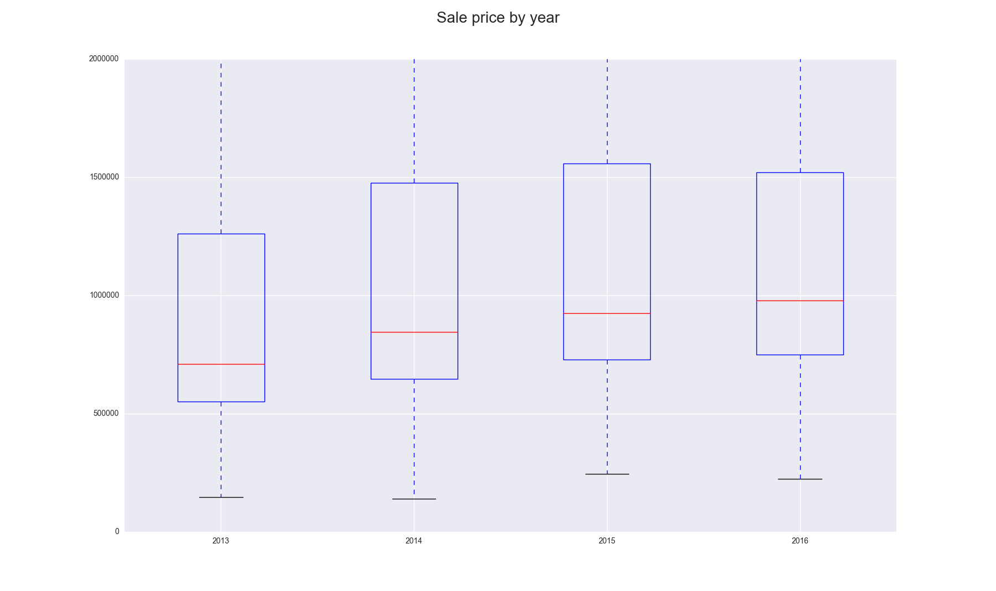
Exploratory data analysis

Slide 5
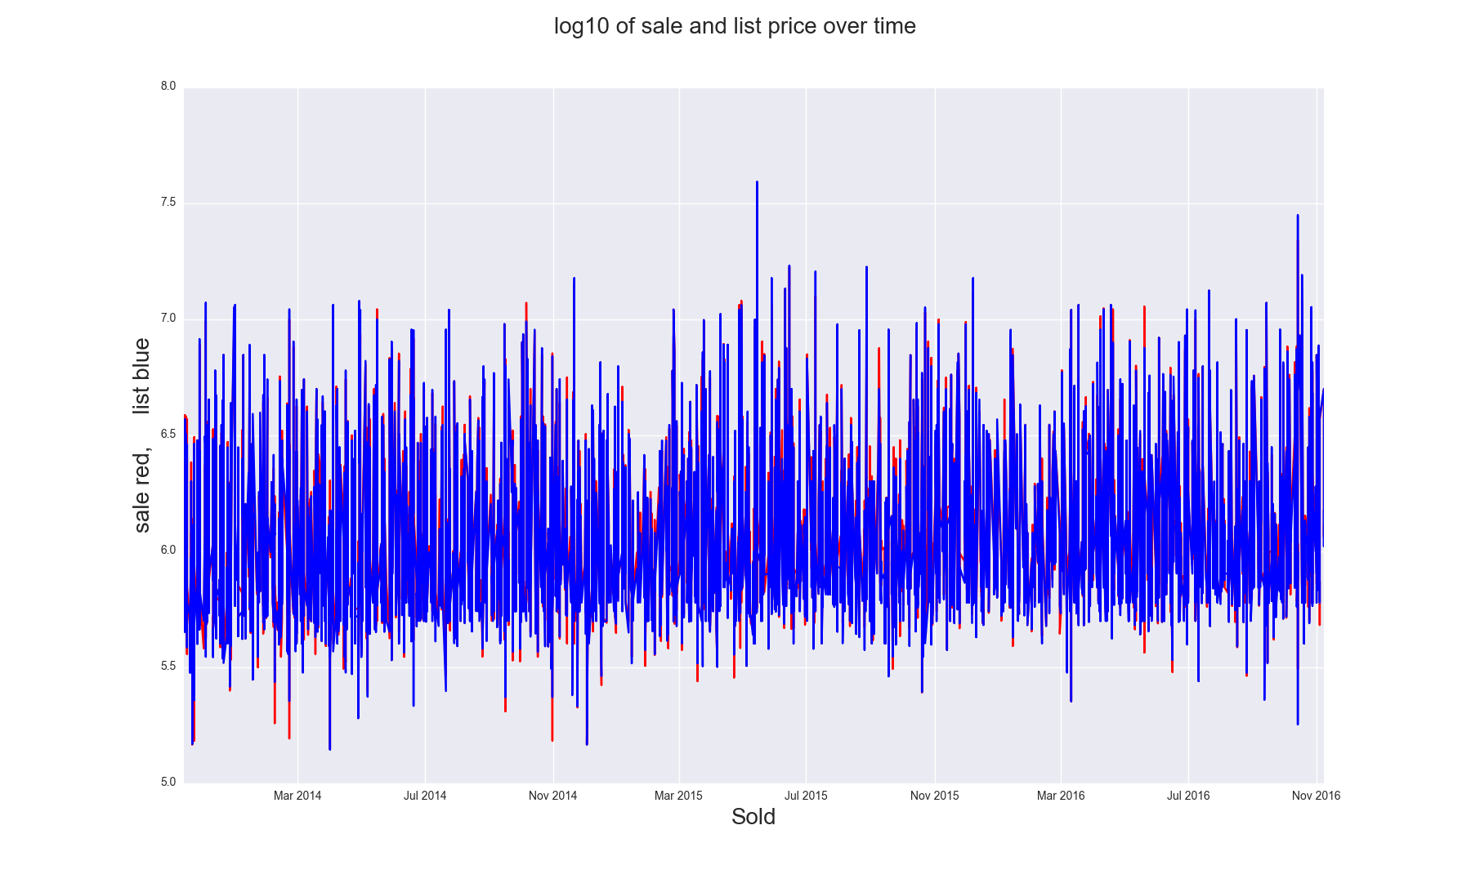
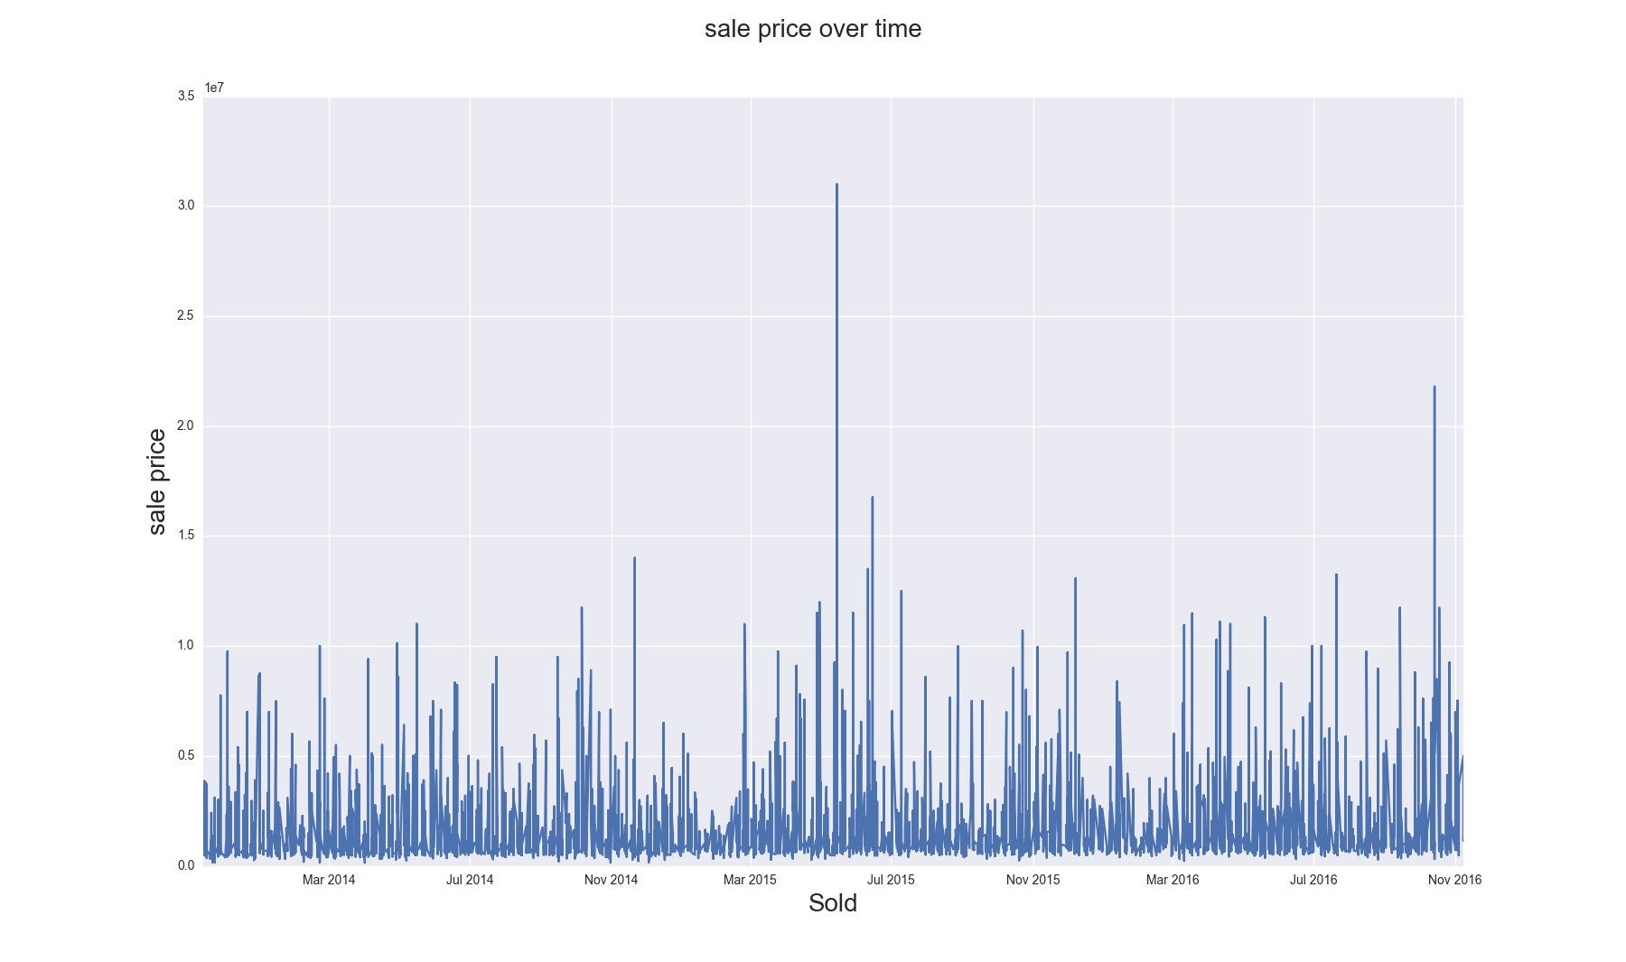
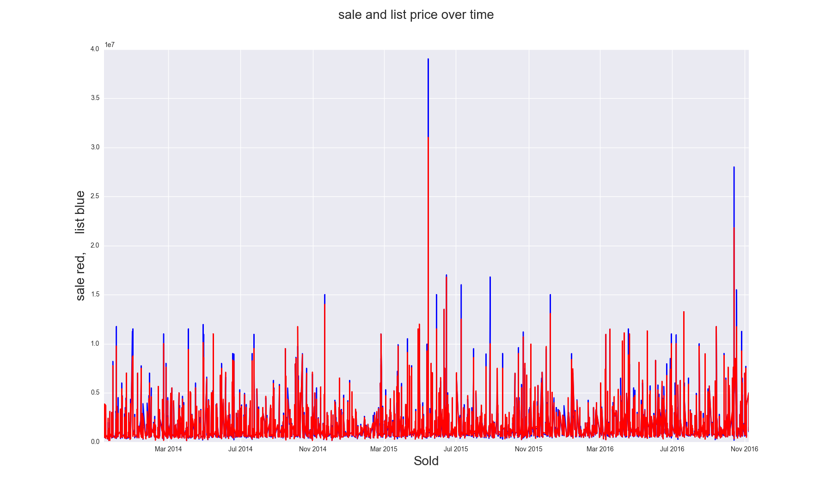
Exploratory data analysis

Slide 6
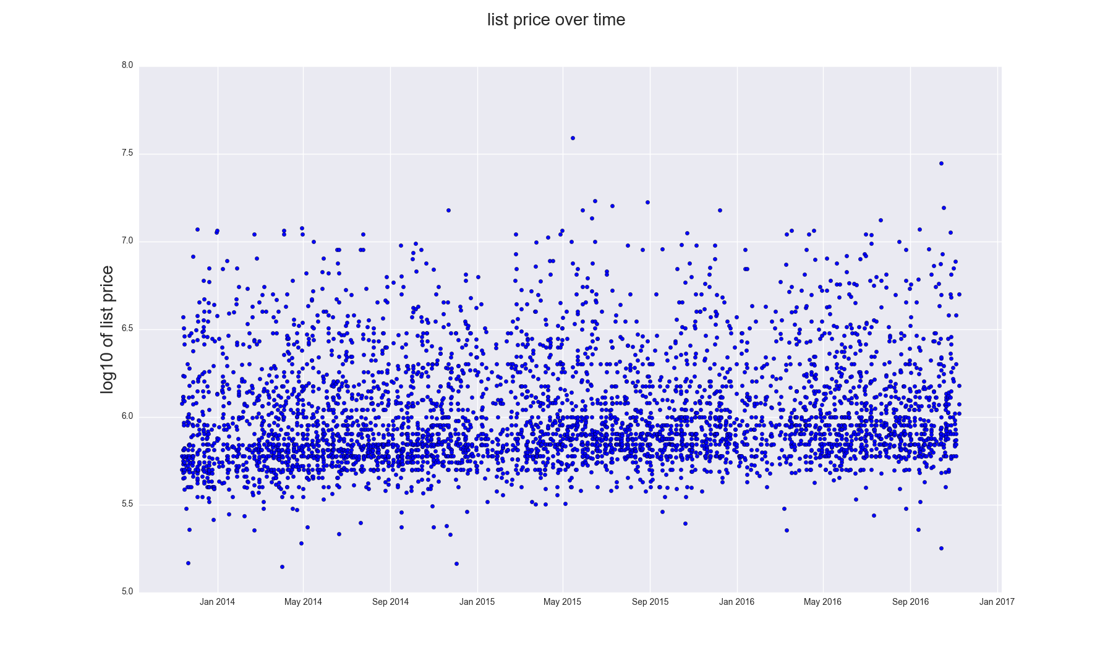
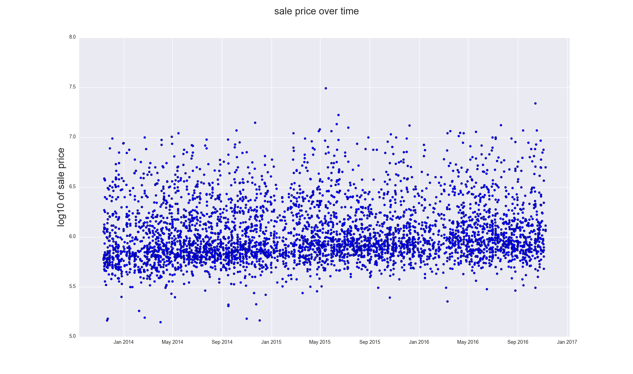
Exploratory data analysis
Exploratory data analysis

Slide 7
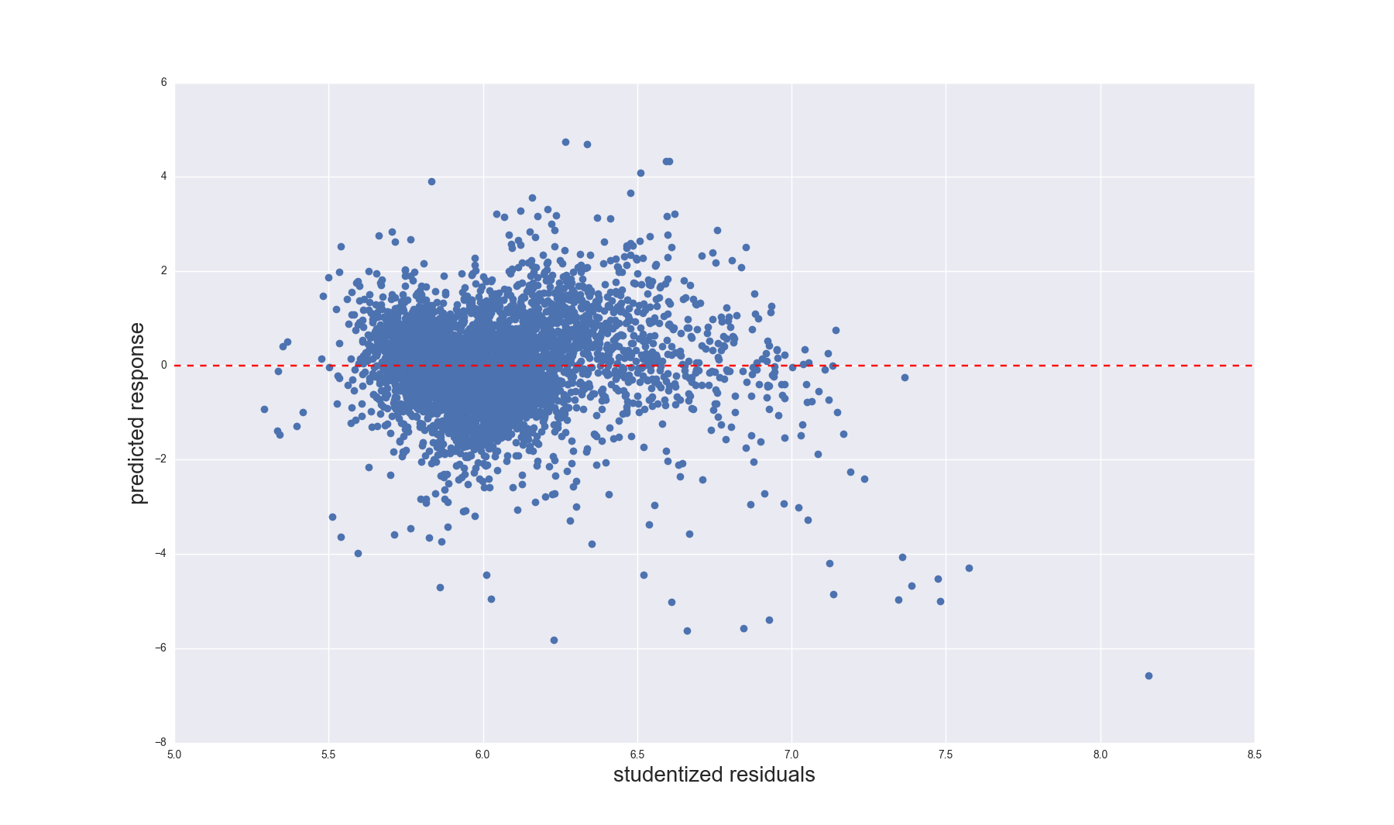
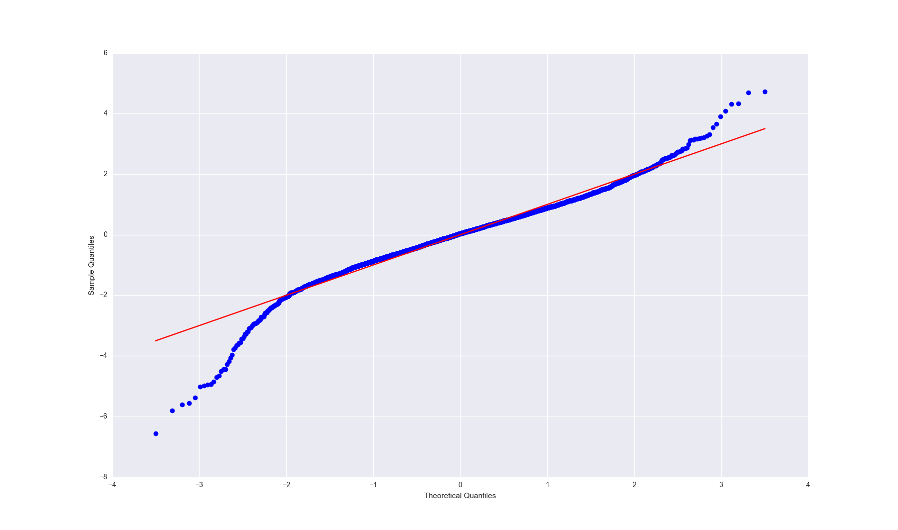
Exploratory data analysis
Exploratory data analysis

Slide 8
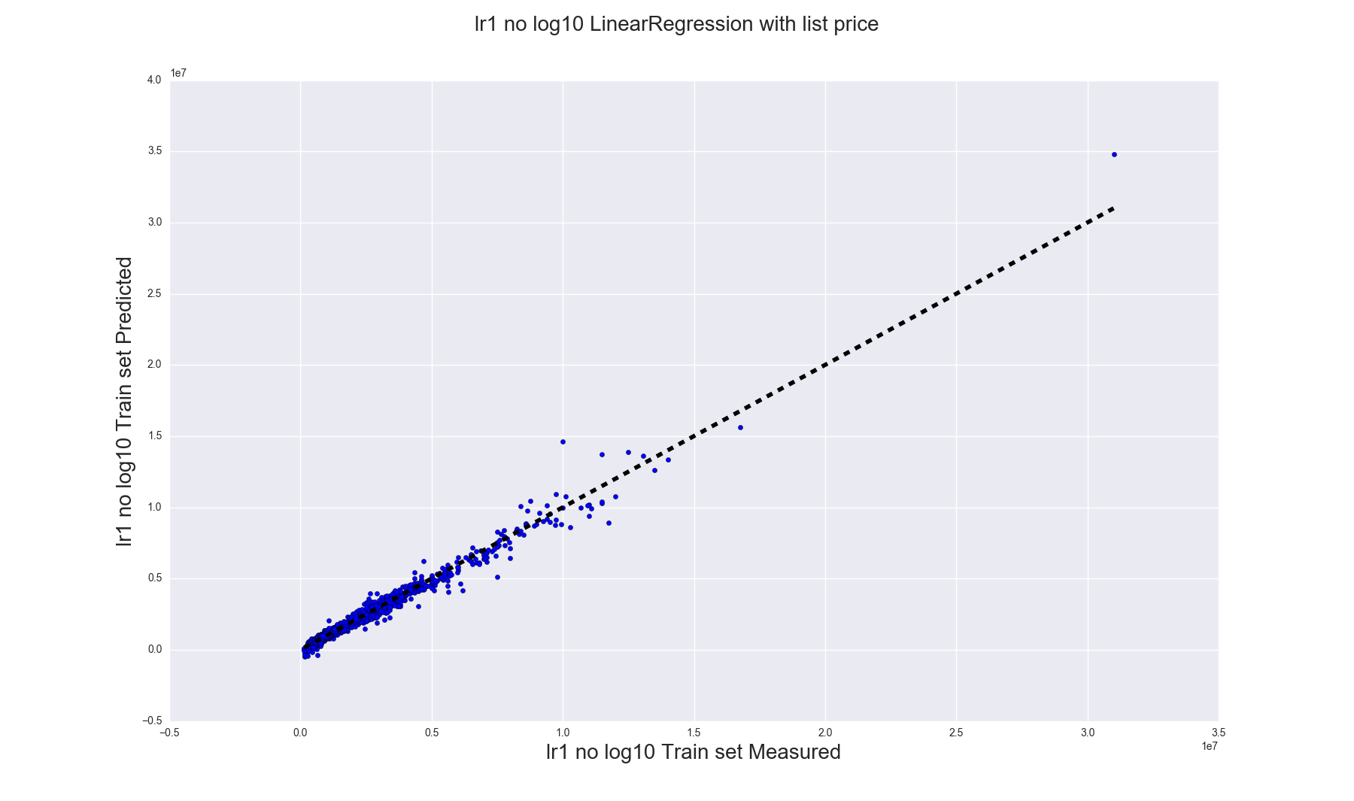
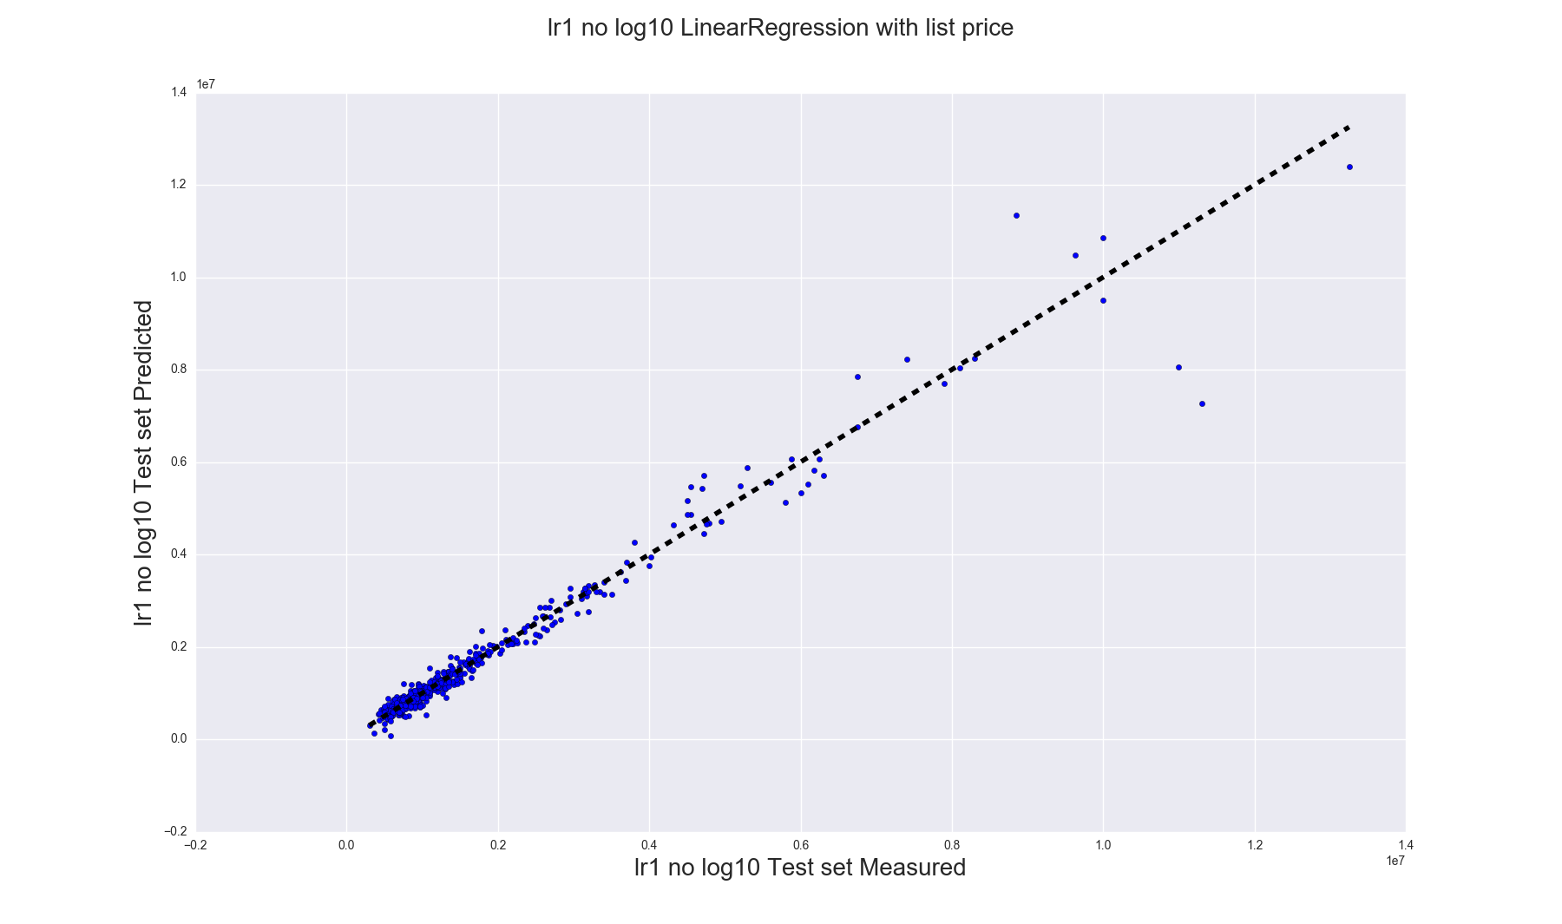
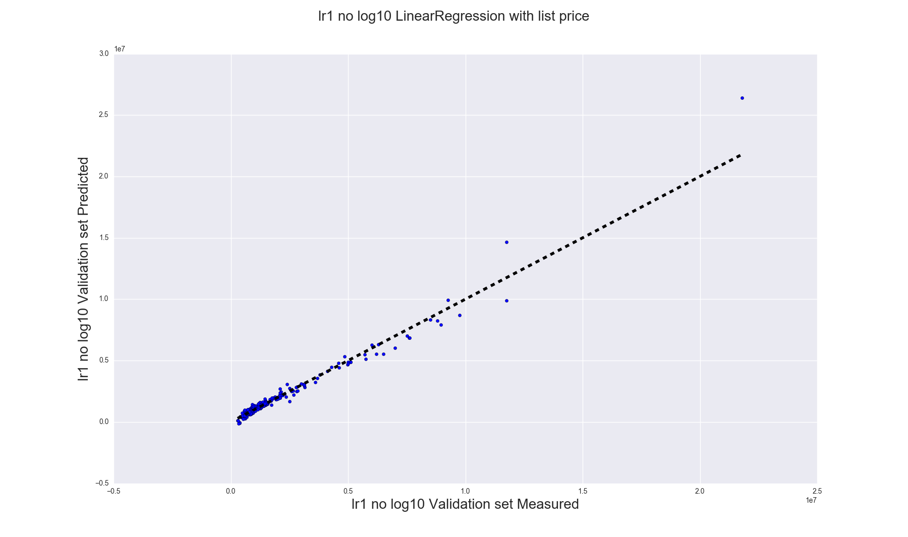
Linear Regression with list price Train Variance score: 0.98 Test Variance score: 0.96 Validation Variance score: 0.98
model with year month columns, no log10:
OLS Regression Results
=======================================================
Dep. Variable: sale_price R-squared: 0.978
Model: OLS Adj. R-squared: 0.978
Method: Least Squares F-statistic: 5925.
Date: Tue, 29 Nov 2016 Prob (F-statistic 0.00
Time: 12:25:23 Log-Likelihoo -59955.
No. Observations: 4339 AIC: 1.200e+05
Df Residuals: 4305 BIC: 1.202e+05
Df Model: 33
Cross-Validated Predictions

Slide 9
Linear Regression with list price With log10 of prices Train Variance score: 0.98 Test Variance score: 0.96 Validation Variance score: 0.98
model with log10 list price:
OLS Regression Results
=======================================================
Dep. Variable: np.log10(sale_price) R-squared: 0.980
Model: OLS Adj. R-squared: 0.980
Method: Least Squares F-statistic: 6302.
Date: Tue, 29 Nov 2016 Prob (F-statistic 0.00
Time: 12:25:23 Log-Likelihoo 7569.7
No. Observations: 4339 AIC: -1.507e+04
Df Residuals: 4305 BIC: -1.485e+04
Df Model: 33
Cross-Validated Predictions

Slide 10
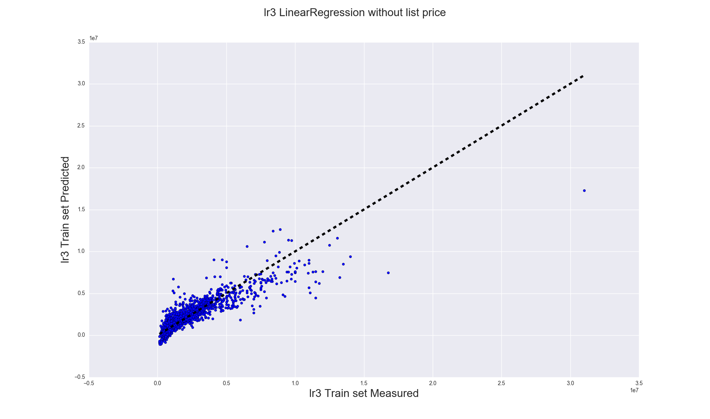
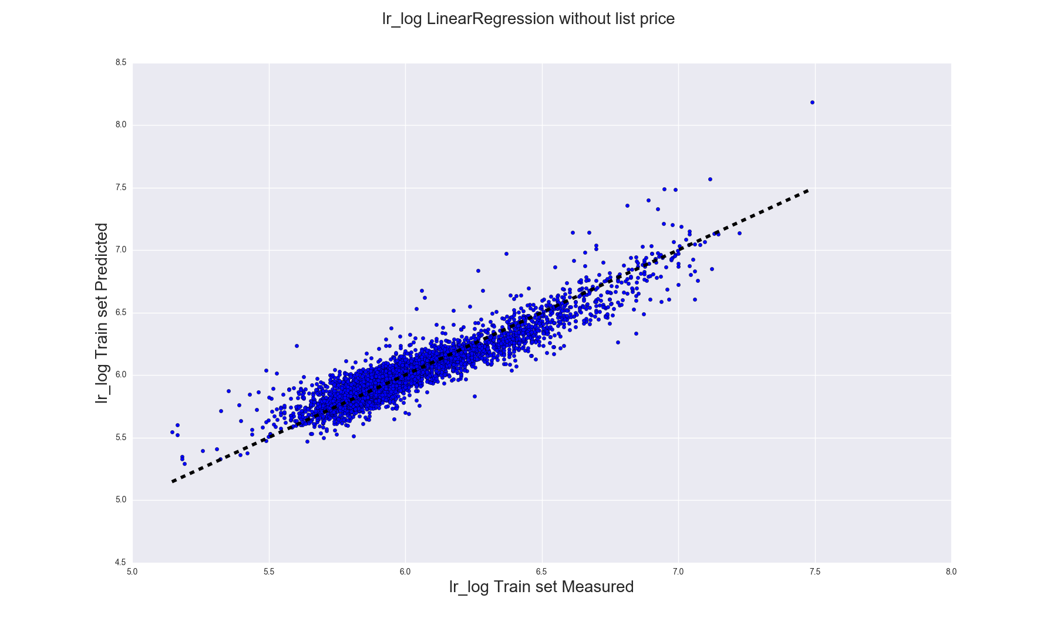
Linear Regression without list Price
model with log10 list price:
OLS Regression Results
=======================================================
Dep. Variable: np.log10(sale_price) R-squared: 0.867
Model: OLS Adj. R-squared: 0.866
Method: Least Squares F-statistic: 880.6
Date: Tue, 29 Nov 2016 Prob (F-statistic 0.00
Time: 12:25:23 Log-Likelihoo 3496.9
No. Observations: 4339 AIC: -6928.
Df Residuals: 4305 BIC: -6717.
Df Model: 33
Cross-Validated Predictions

Slide 11
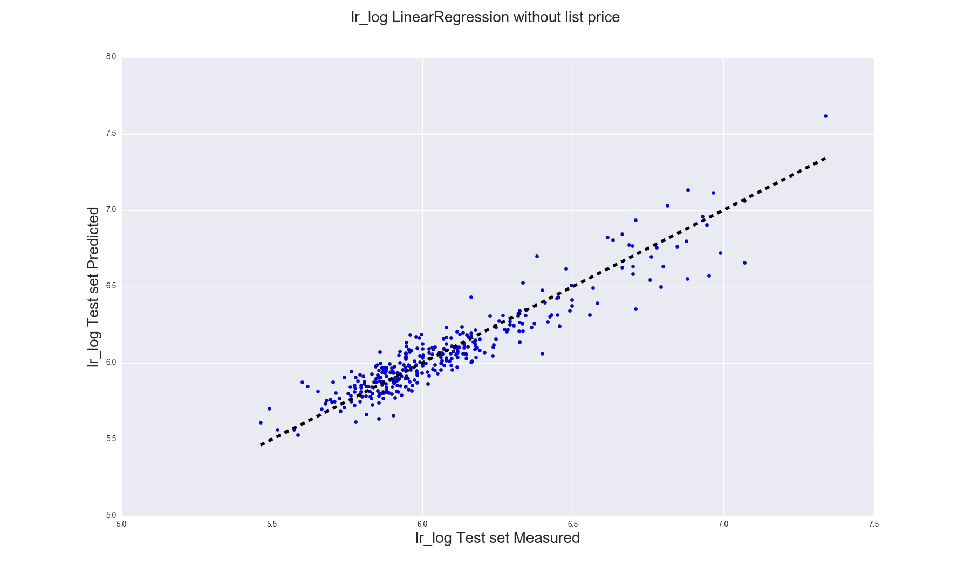
Linear Regression without list price, with log10 sale price
lr_log Train Variance score: 0.87lr_log Test Variance score: 0.87
Date Square-Foot Sale-price Predicted price
2016-08-16 1050 980000.0 1113973.86
2016-08-16 1312 850000.0 619429.93
2016-08-16 700 917500.0 1207900.75
2016-08-16 760 670000.0 602939.08
2016-08-16 4617 9750000.0 5256578.14
2016-08-17 550 699000.0 951734.09
2016-08-17 527 385000.0 338296.01
2016-08-17 1000 775000.0 639240.18
2016-08-17 1210 1050000.0 824167.77
2016-08-17 975 790000.0 625026.51
2016-08-17 1140 1100000.0 973377.38
2016-08-18 1290 755000.0 883667.87
2016-08-18 1841 1850000.0 2044310.57
2016-08-18 1350 1475000.0 1382372.23
2016-08-18 460 760000.0 820469.61
2016-08-19 825 595000.0 530407.16
2016-08-19 1300 925000.0 716916.79
2016-08-19 1200 765000.0 645015.74
2016-08-19 650 779000.0 988819.88

Slide 12
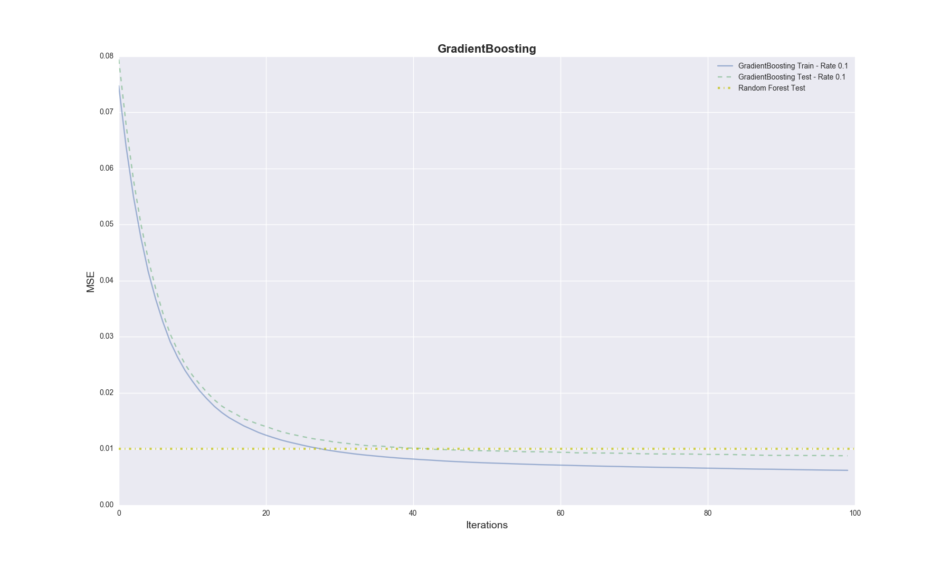
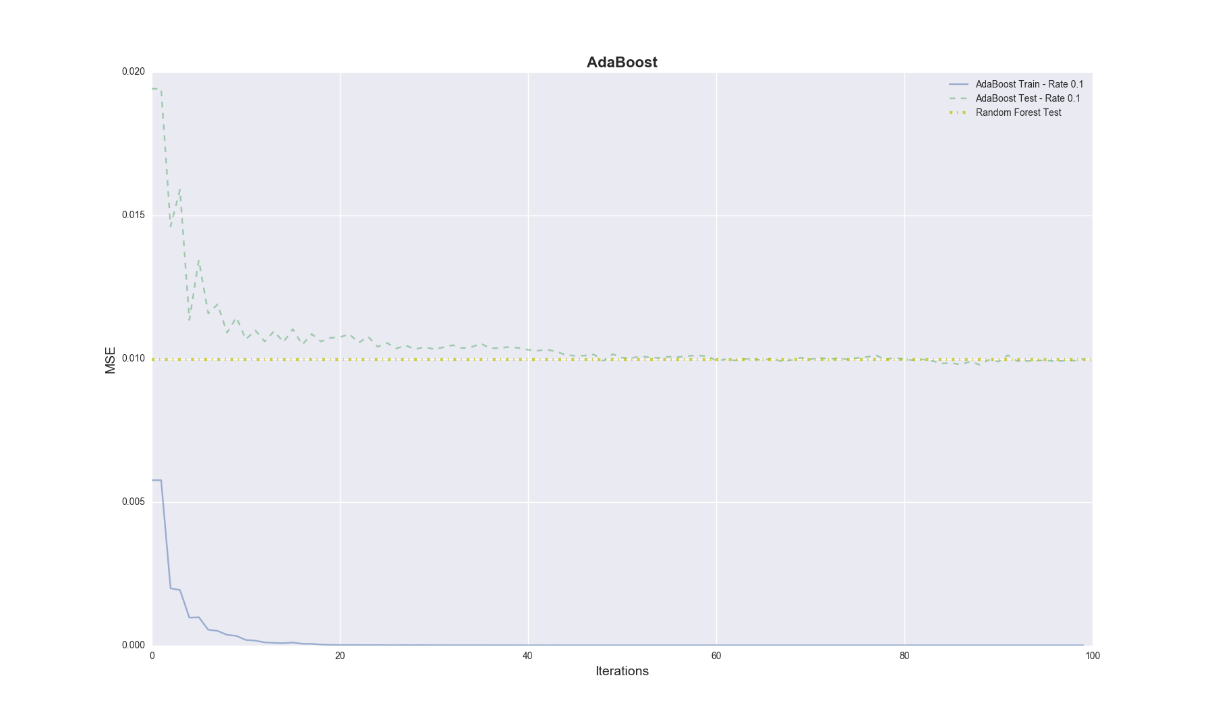
Choosing the final model:
Random Forest Regressor
Gradient Boosting Regressor
Ada Boosting Regresso
RandomForestRegressor Train CV | MSE: 0.008 | R2: 0.904
GradientBoostingRegressor Train CV | MSE: 0.008 | R2: 0.906
AdaBoostRegressor Train CV | MSE: 0.009 | R2: 0.901

Slide 13
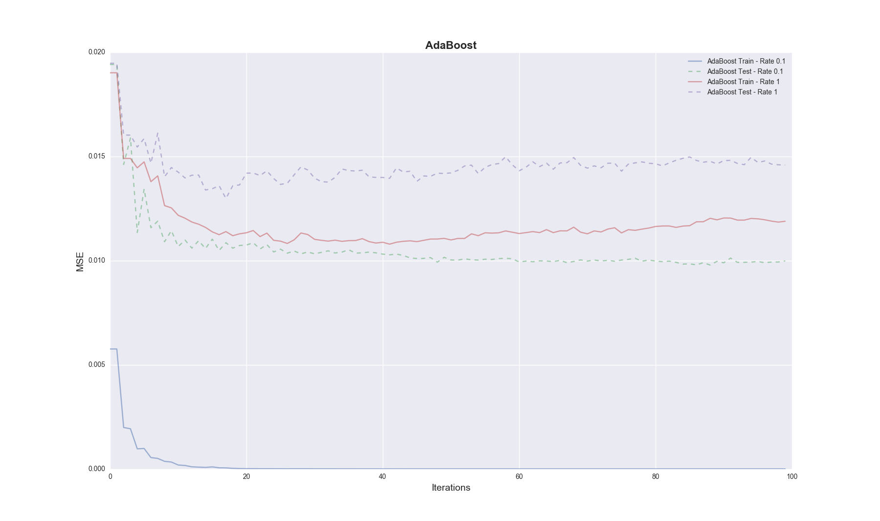
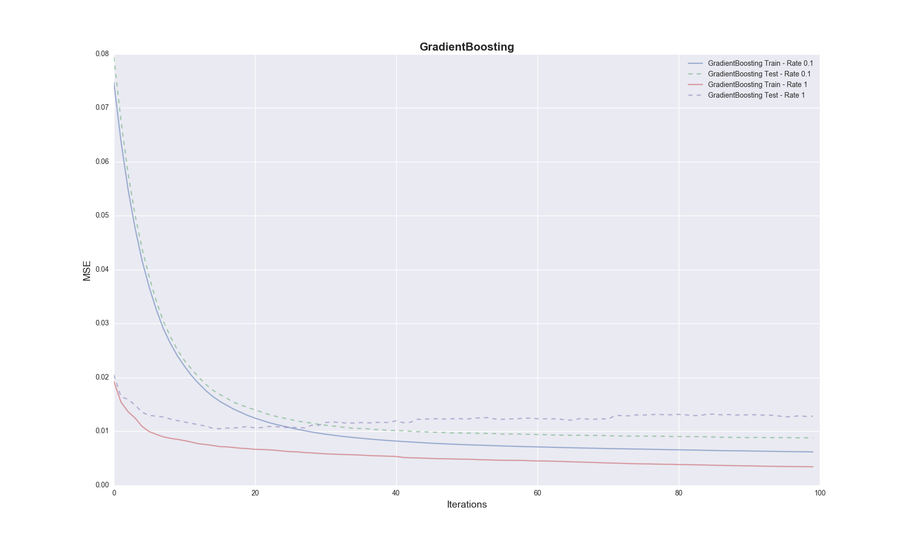
Choosing the final model: Grid Search for best estimators
Grid search RandomForestRegressor
Fitting 3 folds for each of 324 candidates, totalling 972 Done 52 tasks | elapsed: 2.1s
Done 352 tasks | elapsed: 14.0s
Done 657 tasks | elapsed: 28.2s
Done 972 out of 972 | elapsed: 45.5s finished
Grid search GradientBoostingRegressor
Fitting 3 folds for each of 96 candidates, totalling 288 Done 34 tasks | elapsed: 6.0s
Done 184 tasks | elapsed: 44.4s
Done 288 out of 288 | elapsed: 1.2min finished

Slide 14
Final Model: Gradient boosting regressor
GradientBoostingRegressor Train CV | MSE: 0.007 | R2: 0.919
RandomForestRegressor Train CV | MSE: 0.007 | R2: 0.914
Gradient Boost Test MSE: 0.00806594315088
Gradient Boost Test R2: 0.90601555473
Random Forest Test MSE: 0.00834159580026
Random Forest Test R2: 0.900919571981Gradient Boost Test MSE: 0.00806594315088Gradient Boost Test R2: 0.90601555473
GradientBoostingRegressor best estimator:
GradientBoostingRegressor(alpha=0.9, criterion='friedman_mse', init=None, learning_rate=0.02, loss='ls', max_depth=6, max_features=0.3, max_leaf_nodes=None, min_impurity_split=1e-07, min_samples_leaf=5, min_samples_split=2, min_weight_fraction_leaf=0.0, n_estimators=500, presort='auto', random_state=1, subsample=1.0, verbose=0, warm_start=False)

Slide 15
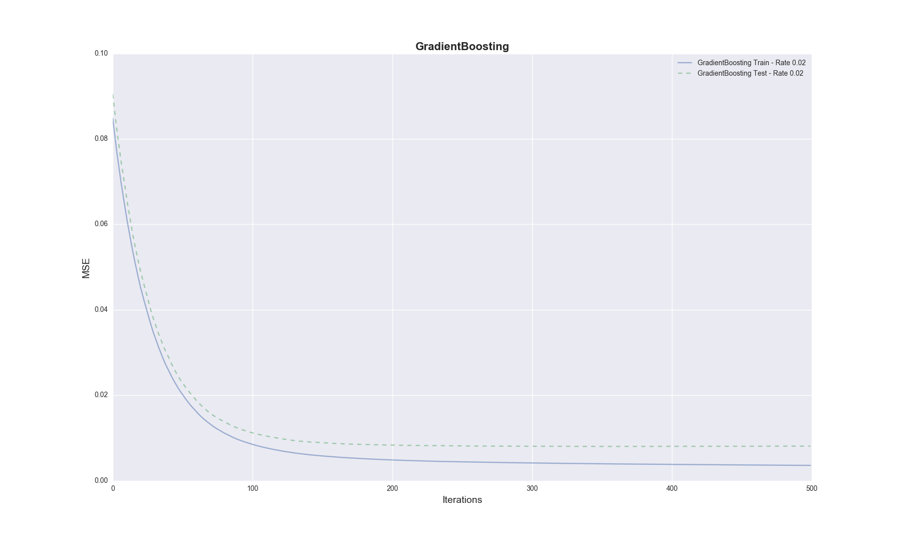
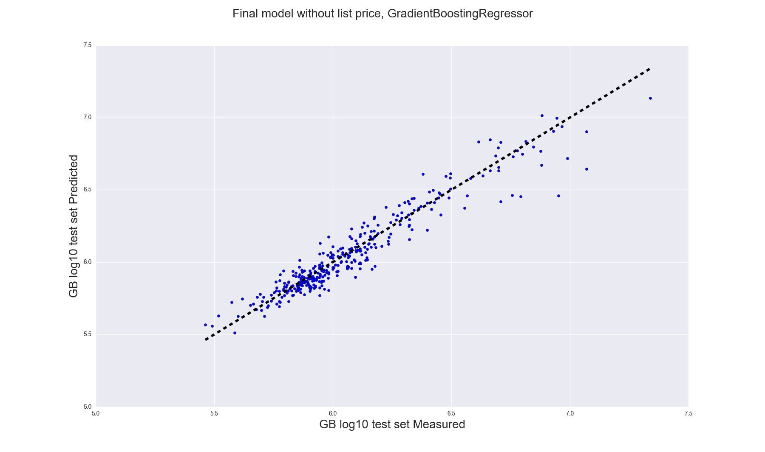
Gradient boosting regressor

Slide 16
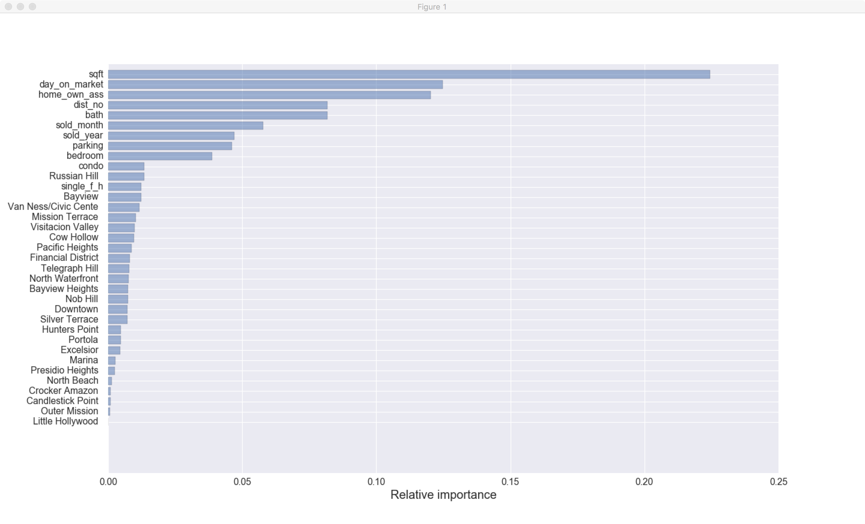

Slide 17
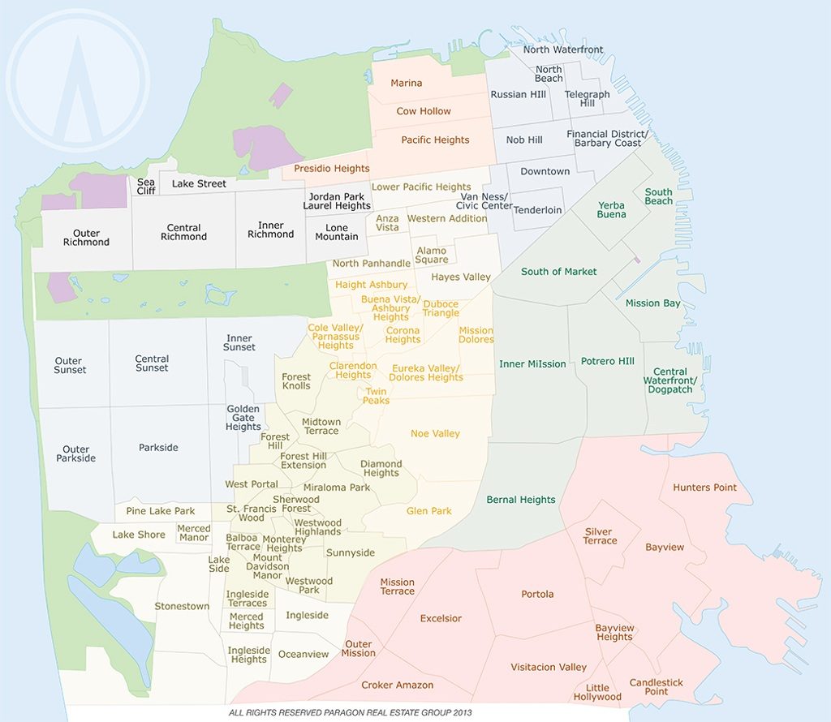
Predictions:
Date Square-Foot Sale-price Predicted price
2016-08-16 1050 980000.0 1167352.68
2016-08-16 1312 850000.0 763698.09
2016-08-16 700 917500.0 885745.47
2016-08-16 760 670000.0 634854.98
2016-08-16 4617 9750000.0 5233383.73
2016-08-17 550 699000.0 800931.58
2016-08-17 527 385000.0 326196.34
2016-08-17 1000 775000.0 691178.71
2016-08-17 1210 1050000.0 950538.13
2016-08-17 975 790000.0 704674.36
2016-08-17 1140 1100000.0 1256932.34
2016-08-18 1290 755000.0 781256.91
2016-08-18 1841 1850000.0 1955437.64
2016-08-18 1350 1475000.0 1450500.51
2016-08-18 460 760000.0 598951.42
2016-08-19 825 595000.0 537174.79
2016-08-19 1300 925000.0 812582.63
2016-08-19 1200 765000.0 736850.25
2016-08-19 650 779000.0 742334.78
2016-08-19 985 1200000.0 1243071.86
2016-08-19 751 715000.0 691536.8
2016-08-19 534 640000.0 614388.93

Slide 18
Conclusion and future work
More data is needed: individual sales across the City, for all districts for at least 5 years. That data would allow us to analyze time series better, and the model selection through grid-search and cross-validated estimator would give us more reliable results.

